Slide 1

Drowsiness Detection
Group members :
Vishal Rathod
Shubham Jamdar
Sanaga Shashank Reddy
Kaustubh Dangche
Abhishek Pradhan
Under the Guidance:
Prof. Rahul Borate

Slide 2
INDEX
Introduction
Literature Review
Research Gaps
Objectives
Methodology
Conclusion
Future Scope
References

Slide 3
Introduction
Drowsiness is among the important factors that cause traffic accidents; therefore, a monitoring system is necessary to detect the state of a driver's drowsiness. Driver monitoring systems usually detect three types of information: biometric information, vehicle behavior, and driver's graphic information. For this project, we are going to use the MRL Eye dataset. MRL Eye dataset is a large-scale dataset that contains human eye images.
Tools we used –
Python
Keras
Tensorflow
Opencv

Slide 4
Literature Review
1.Driver Drowsiness Detection -
Dr. Nagamani N P Assistant Professor Dept. of Information Science and Engineering JSS Academy of Technical Education Bengaluru, India .
2. Driver Drowsiness Detection System and Techniques-
Vandna Saini Research Scholar, CSE Department Chandigarh University Gharuan, Punjab, India. Rekha Saini Assistant Professor, CSE Department Chandigarh University Gharuan, Punjab, India.
3. Driver Drowsiness Detection System Based on Feature Representation Learning Using Various Deep Networks
Fei pang ,chang d yoo, sunghun kang

Slide 5
Research Gaps
It detects drowsiness and the sensor produces vibrations to the seat.
With this project it helps us to improve our night vision
It produces a buzzer sound when drowsiness is detected

Slide 6
Objectives
Driver drowsiness detection is a car safety technology which helps to save the life of the driver by preventing accidents when the driver is getting drowsy.
The main objective is to first design a system to detect driver’s drowsiness by continuously monitoring retina of the eye.
The system works in spite of driver wearing spectacles and in various lighting conditions.
To alert the driver on the detection of drowsiness by using buzzer or alarm.

Slide 7
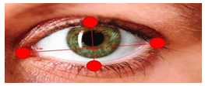
Nonfunctional Requirements
Image processing is done using the captured video.
Image is stored in a library called OpenCV.
Stored image undergo various algorithm and detects if the driver is fatigue and if fatigue raises an alarm.
System Requirements
Software Requirements Specification
Python: Python 3.6 and higher version
Libraries
Numpy, Scipy , Playsound, keras, opencv, etc.
Operating System
Windows or Ubuntu
Hardware Requirements
Processor: 64 bit, quad-core, 2.5 GHz minimum per core
RAM: 4 GB or more.
HDD: 20 GB of available space or more.
Display: Dual XGA (1024 x 768) or higher resolution monitors.
Camera: A detachable webcam.
Keyboard: A standard keyboard

Slide 8
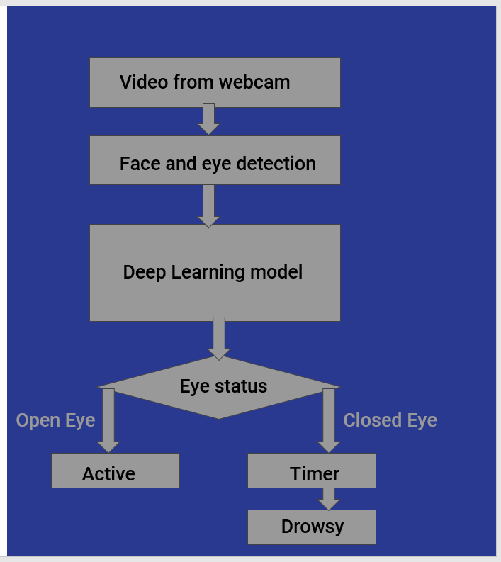
methodology

Slide 9
Methodology
The methodology of this project is the first video is captured using a webcam and from the video first face is detected using the Harcascade algorithm and then the eyes are detected. Then we use our deep learning model which is built using transfer learning to know the status of the eye. If it is an open eye then it will say Active and if it is a closed eye then it will check for a few seconds and then it will say the driver is drowsy and will beep an alarm.

Slide 10
Conclusion
It completely meets the objectives and requirements of the system. The framework has achieved an unfaltering state where all the bugs have been disposed of. The fact that it takes care of the issue of stressing out for individuals having fatigue- related issues to inform them about the drowsiness level while driving. This drowsiness detection system helps the drivers a lot and prevents many road accidents that are caused due to drowsiness

Slide 11
Future Scope
The future works may focus on the utilization of outer factors such as vehicle states, sleeping hours, weather conditions, mechanical data, etc, for fatigue measurement. Driver drowsiness pose a major threat to highway safety, and the problem is particularly severe for commercial motor vehicle operators. Twenty-four hour operations, high annual mileage, exposure to challenging environmental conditions, and demanding work schedules all contribute to this serious safety issue. Monitoring the driver’s state of drowsiness and vigilance and providing feedback on their condition so that they can take appropriate action is one crucial step in a series of preventive measures necessary to address this problem. Currently there is not adjustment in zoom or direction of the camera during operation. Future work may be to automatically zoom in on the eyes once they are localized.

Slide 12
References
[1] https://blog.rebellionresearch.com
[2] https://www.frontiersin.org
[3] https://www.analyticsvidya.com
[4] http://mrl.cs.vsb.cz/eyedataset

